Slide 1

New Horizon Institute of Technology and Management, Thane
Department of Computer Engineering
Kick it
By
Vratesh Ghadge 12212012
Om Ghag 12212039
Sana Girish 12242001
Guided by: Ms. Radhika Patil

Slide 2
Problem Statement and Objectives
Problem statement : The football game involves two teams competing in a match to score the highest number of points within a specified time frame. Each team has unique strengths and weaknesses, influencing their performance throughout the game.
Objectives:
Performance Analysis
Game Strategy Development
Scoring Optimization
Fan Engagement
Post-Game Review
Kick it

Slide 3
Workflow
Start
Tactical planning
Warm up
Tactical adjustment
Pre game preparation
In game management
Kick off
Review and adjust
Halftime Break
Game play
Second half
End of game
Kick it

Slide 4
Implementation Details
Dates​ | Implementation​
19/07/24 – 31/07/24​ | Topic Finalisation – “Kick it” topic has been finalised.​
5/08/24 – 13/08/24​ | Discussed the plan of execution starting with requirement analysis.
11/08/24 – 13/08/24​ | Working on implementation.
21/08/24 – 26/08/24​ | Completed with Front page (Football grond, players, audience).
​27/08/24 – 12/08/24 | ​Working on Backend.
​ | ​
Meal Mapper

Slide 5
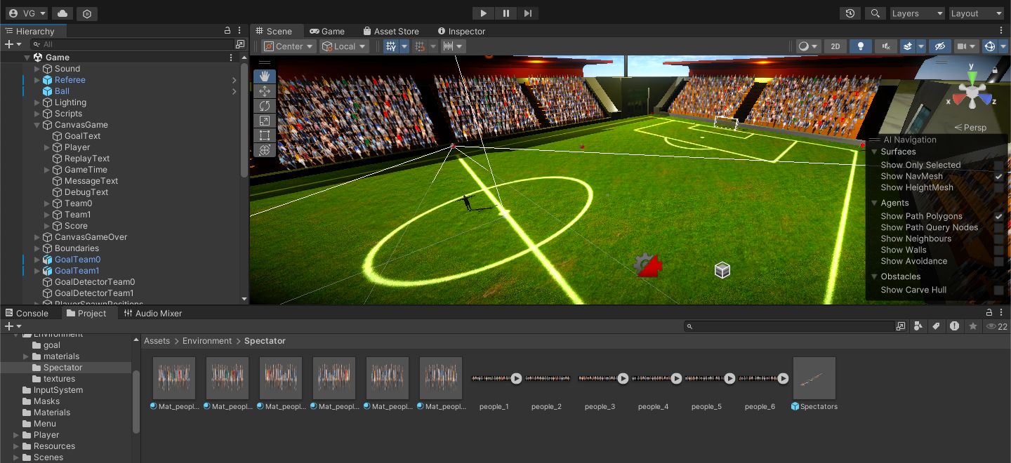
Result Screenshot
Kick it

Slide 6
References
B. J. MacDonald, M. R. Anderson, and J. H. Chen, "Game Design with Unity: A Case Study of a Soccer Game," in Proceedings of the 2019 IEEE International Conference on Artificial Intelligence and Virtual Reality (AIVR), pp. 45-50, 2019.
DOI: 10.1109/AIVR47813.2019.00011
T. G. K. N. Kumar, R. A. K. Arora, and R. Kumar, "Development of an Interactive Soccer Game Using Unity," in IEEE Access, vol. 8, pp. 65023-65034, 2020.
DOI: 10.1109/ACCESS.2020.2983440

Slide 7
THANK YOU

